Slide 1
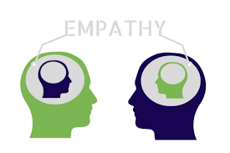
Empathy
Notes:
Hello Vertos, welcome you to our fourth lecture which is based on empathy but before discuss about it let’s have the overview of this topic .

Slide 2
What is Empathy?
Empathy is the capacity to understand or feel what another person is experiencing from within their frame of reference, that is, the capacity to place oneself in another's position.
Notes:
It also is the ability to feel and share another person's emotions. Some believe that empathy involves the ability to match another's emotions, while others believe that empathy involves being tenderhearted toward another person.

Slide 3


Slide 4
We will cover topics:-
What is Empathy
Difference between Sympathy and Empathy
Importance of Empathy
Types of Empathy
How to develop Empathy in us
Notes:
These topics designed keeping in mind that you will get a good overview on Empathy and its importance and how it affects.

Slide 5

Notes:
Thank you and see you soon!

